Slide 1

Document Management System and Information Centre
~GreekHackers

Slide 2
TEAM MEMBERS
Ketro Sithole – Team leader
Kudakwashe Chivunga – Deputy leader
Isaac Choma
Precious Nhlapo
Abdud-Dayyaan Sedick
Lettie Molapisi
Paballo Mathipa

Slide 3
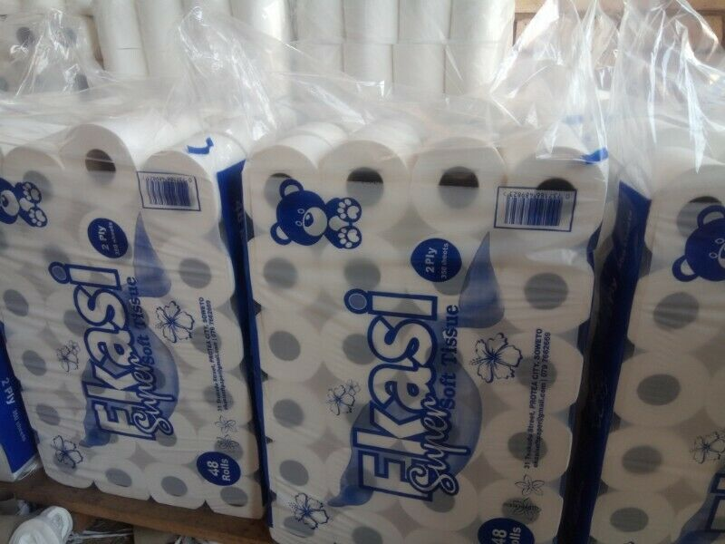
PROBLEM STATEMENT
“How can we, through tech solutions, solve for Township”
SMMEs’ business information and data challenges to improve their business efficiencies”.

Slide 4
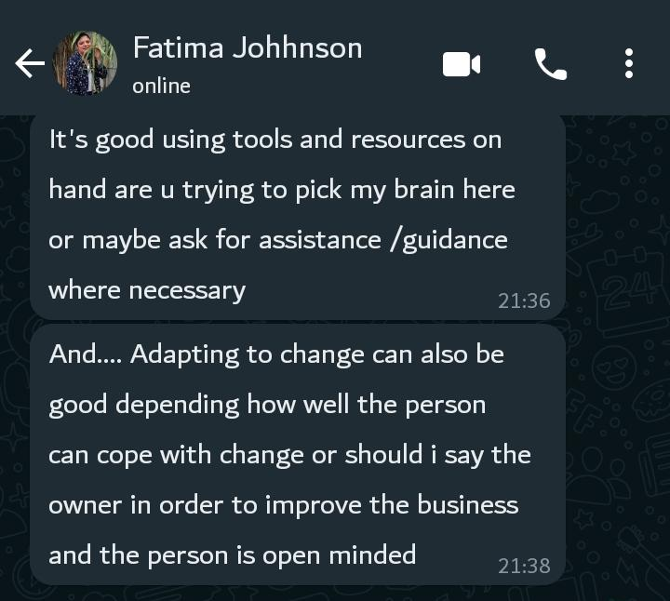
Feedback from SMALL BUSINESS OWNERS
Based off the Information we got from actual small business owners

Slide 5

Proposed Solution
Many SMME’s struggle to grow their businesses, reason being the lack of knowledge as well using outdated practices to store vital information, greatly contributes to this downfall.
So, we decided to create a user-friendly and affordable Document Management System and Information center that allows SMMEs to store their information in a orderly manner ,and that information can be saved /backed up on the cloud.
Alongside this DMS is An Information Center where they can be able to get informative knowledge and advice that can educate them on how to grow their business, this would be crucial for small business owners in Thembisa and across South Africa .
Video Tutorials

Slide 6
IMPACTION JOURNEY HACKATHON JOURNEY
How could solving the problem add value to the society? What company objectives are you going to address and achieve?
The Document management System aims at solving the problem of storing important information in Books. Most of the companies still rely on outdated practices that don’t produce results and require a ton of effort e.g. Like using books for storing their important information that can be lost anytime.
The way data is stored plays a major role in how easy it is to control access, use and protect their information.
When business information is properly collected, managed and disposed of at the end of its lifecycle, it reduces the risk of theft, security breaches and physical damage, while aiding business intelligence and operations

Slide 7

PRODUCTS – Unique selling point (USP)
Document Management System/ Information
Our system has integrated:
The information Centre which has links of vital information that can be used by business owners to upscale their businesses.
And a Document Management System that can be used to store business’s information ( Invoices, Business reports, financial documents, etc.)
Our System is affordable because It consume less() data to fully function

Slide 8
FINANCIAL VIABILITY
We can generate revenue through subscriptions(Monthly or Annually) – by selling access to the content/ features(Members who subscribe will get premium content with more features)
Advertisement - in app advertising for the free version and if the business owner subscribes to the book app system, the ads will be removed.
Purchases – in app purchasing, will allow the business owner to get access to the database that have to the best information about (suppliers, customers, etc.)

Slide 9

MARKETING STRATEGY
Search engine optimisation – this makes sure that our book app system and information centre is optimised when a business owner searches for a book system app.
Social media – we can build a brand that is centred about our product and the benefits that it brings on owning it.
Word of mouth – encouraging people to share our product with others through word of mouth to drive more business.
Content marketing – creating livestreams, webinars through different platforms will be a great way to have an engagement with business owners.
Using inside sales team phone/email to qualify based on lead scoring. Generate marketing qualified leads that need to be nurtured.

Slide 10
DEMO
Document Management System and Information Centre demo

Slide 11
Thank You For Your Time.

